Slide 1
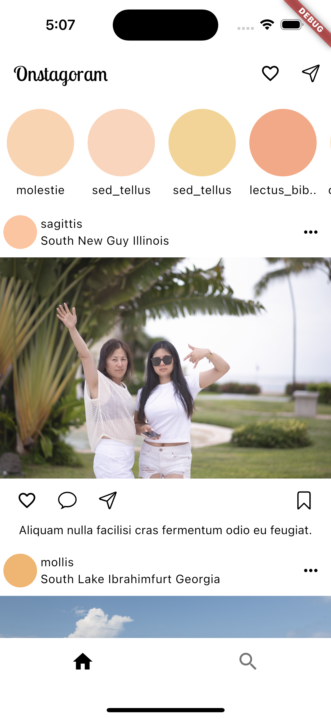
AppBar
Body: HomeView()
BottomNavigationBar

Slide 2
UserStories
UserStory
Feed menu
Feed User Info
Feed
User Command Bar
Contents of the feed

Slide 3
mainAxisAlignment: MainAxisAlignment.spaceBetween
Row
Text
Text
Comlumn
IconButton
Container
Row
Row

Slide 4
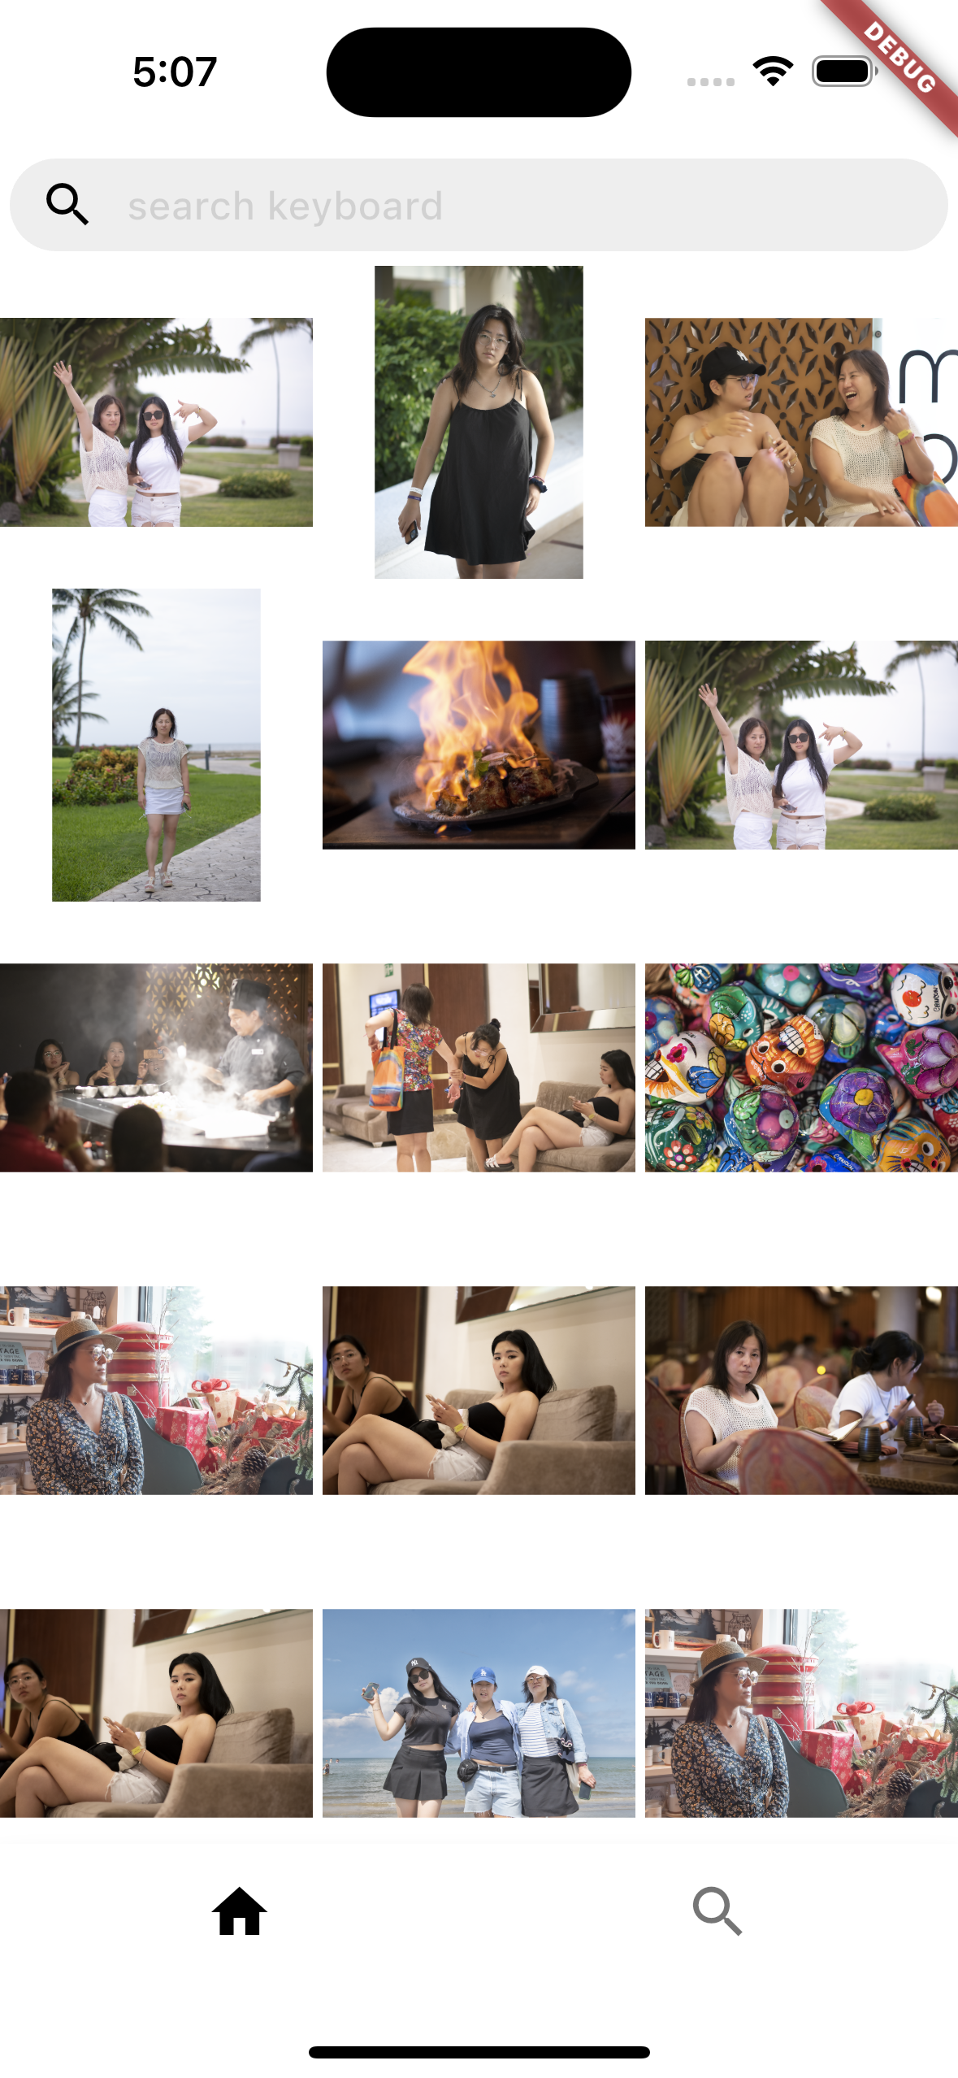
Search Input
Grid View

